Slide 1


OPENING THOUGHT
1

Slide 2
CULTURAL APPROACHES TO PREVENTION: TOOLS TO GUIDE PRACTICE
PREVENTION SOLUTIONS@EDC CULTURAL APPROACHES TO PREVENTION: TOOLS TO GUIDE PRACTICE
2

Slide 3


PRESENTERS
Terri Yellowhammer, JD
Training and Technical Assistance Specialist
Maria Valenti, PhD
Senior Research Associate
Kim Dash, PhD, MPH
Senior Research Scientist
PREVENTION SOLUTIONS@EDC CULTURAL APPROACHES TO PREVENTION: TOOLS TO GUIDE PRACTICE
3

Slide 4

TODAY’S AGENDA
Background and need
Program tools
  Approach to development
  Products for the prevention field
  Potential applications
Questions and Discussion
PREVENTION SOLUTIONS@EDC CULTURAL APPROACHES TO PREVENTION: TOOLS TO GUIDE PRACTICE
4

Slide 5
Culture Can be Defined By…
RELIGION
RACE/
ETHNICITY
GENDER IDENTITY/ SEXUAL ORIENTATION
DISABILITY
CLAN
GEOGRAPHIC LOCATION/
COMMUNITY
INCOME
GENDER
LANGUAGES/ DIALECTS
AGE

Slide 6
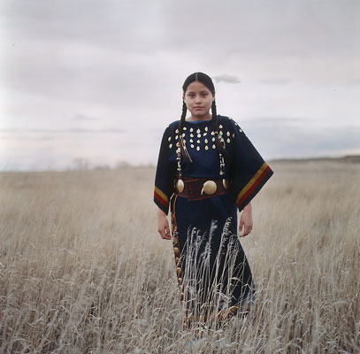
Elements of Culture
Norms
Values
Beliefs
Symbols
Practices
What else?

Slide 7
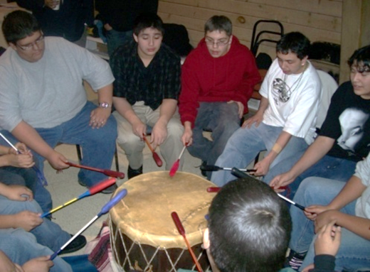
Culture-Based Best Practices
Traditional healing ceremonies
Tribal arts
Songs and dance
Coming of age events
Traditional games
Clans and societies
Storytelling
Culture camps

Slide 8


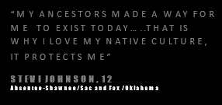
What We Hear from Tribes…
The need for information and guidance on culturally-informed programs
8

Slide 9
Background and Need
Is there one place we can go to obtain information on culturally-informed programs?
How do we measure cultural factors associated with health promotion and substance misuse prevention in AI/AN populations?
Which programs have been developed by tribes, with tribes, or for tribes?
Which culturally-informed programs reduce substance misuse or abuse and/or promote mental health among American Indian and Alaska (AI/AN) populations?
What cultural factors protect against substance misuse and promote mental health among AI/AN populations?

Slide 10
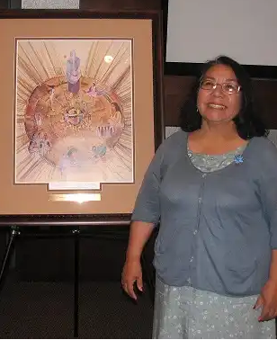
Background and Need
….many practices that have been determined to be evidence based have inadequate or no inclusion of cultural variables in research samples, no examination of the impact of culture(s) on outcomes…
Delores Subia Big Foot of the
Indian Country Child Trauma Center

Slide 11
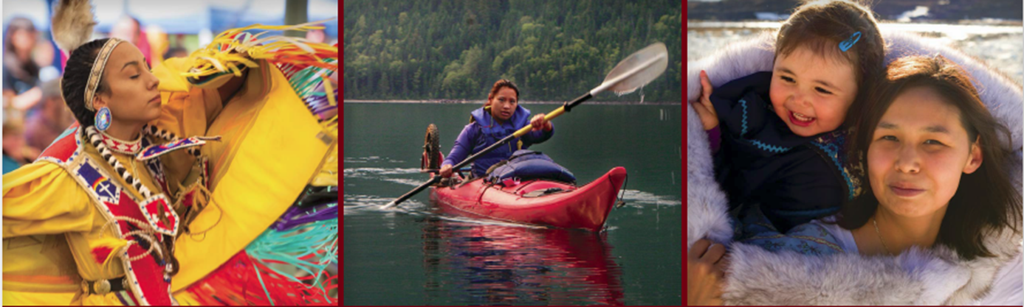
Our Overall Approach
Have external native voice
Invite national tribal experts to review the tools
Recognize we cannot place onus on one person
11

Slide 12

questions = three tools
What cultural factors are associated with substance misuse?
How do we assess cultural traditions, practices, and values?
What programs and strategies have been developed to address promote health among tribes?

Slide 13
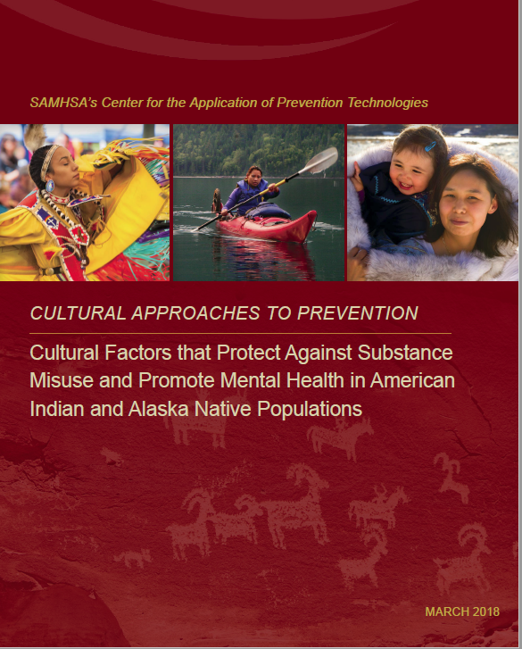
A Review of Cultural Factors
What cultural factors are associated with substance misuse?

Slide 14
Factors review: development
We employed a systematic process.
2005-2016
EBSCO databases
Studies included:
  American Indian or Alaska Native populations
  Demonstrated a direct association between the cultural practice or belief and outcome

Slide 15
Factors review: development
Tribal experts reviewed and asked that we:
Include qualitative studies
Provide context for risk factors
Provide tribal specific information

Slide 16
Factors review: end product
Studies | Factors
8 studies of protective factors | Having a strong AI/AN identity Practicing traditional values Experiencing support and opportunities for connection with family and community
3 studies of risk factors | Experiencing historical trauma (or loss of cultural traditions) Participating in generic (vs. tailored) cultural activities Tribal reservation alcohol use norms Engaging in traditional activities and native traditionalism

Slide 17
Factors review: end product
Protective Factor | Outcome | Population | Citation
Living by traditional way | Lifetime meth use | Pregnant American Indian teens from rural reservation communities in the Southwest US | Barlow et al., 2010
Greater importance ascribed to traditional Indian values
Risk Factor | Outcome | Population | Citation
Historical trauma (or loss of cultural traditions) | Past month smoking; experimental smoking | California American Indian youth | Soto, Baezconde-Garbanati, Schwartz, & Unger, 2015

Slide 18
Factors review: applications
This tool can be used to help you:
Determine which factors are present in your community.
Prioritize the factors
  How important is the factor?
  Does the factor influence other behavioral issues besides substance misuse?
  Is the factor modifiable?
  Is there a suitable evidence-based or practice-based program that can be implemented to promote or deter this factor?

Slide 19
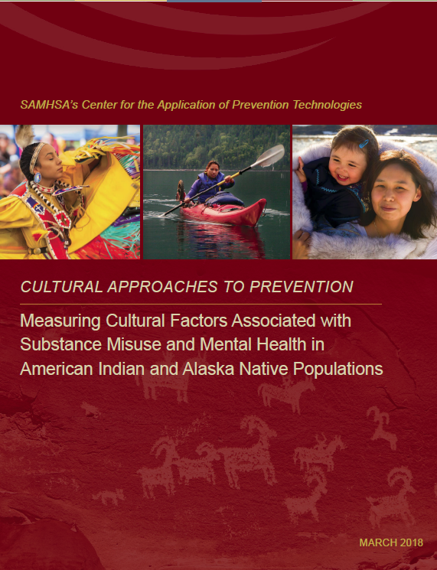
Measures Guide
How do we assess cultural traditions, practices, and values?

Slide 20
Measures Guide: Development
We employed a systematic process.
2005-2016
EBSCO Databases
Search terms:
  “cultural practices”
  “traditional practices”
  “substance use”
  “American Indian”
  “Native American”
  “Indigenous”
  “tribal”

Slide 21
Measures Guide: Development
Tribal experts asked that we:
Make it understandable to people without research training
Include actual measure items when possible
Provide contact information of developer

Slide 22
Measures Guide: End Product
A final tool of measures that includes:
Two main sections
  Can be used for research purposes without further author permission
  Requires users to contact the measure developer for permission to use
33 measures (20 publicly available)
Both quantitative and qualitative studies
Measures specific to a given tribe, as well as pan-ethnic measures

Slide 23
Measures Guide: End Product
A final tool of measures organized by 7 main concepts:
Acculturation or enculturation
Attachment and connectedness
Communal mastery
Ethnic identity
Historical loss
Participation in cultural or traditional activities
Religiosity and spirituality

Slide 24
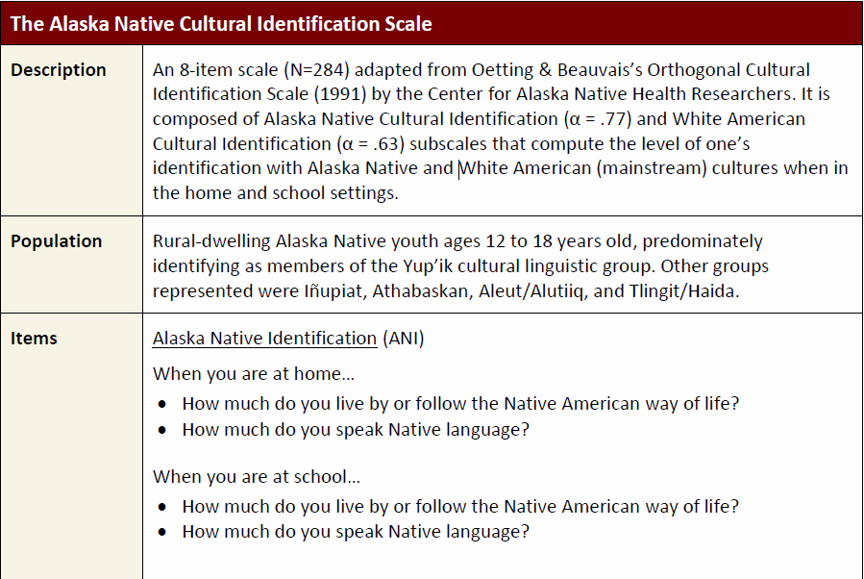
Measures guide: end product

Slide 25
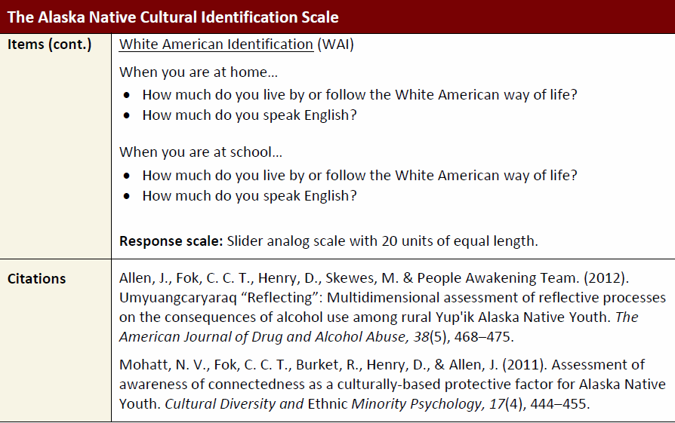
Measures guide: end product

Slide 26
Measures Guide: Applications
This tool can be used to help you:
Document presence or absence of cultural factors
Identify programs that address cultural factors associated with substance misuse
Assess change associated with program implementation

Slide 27
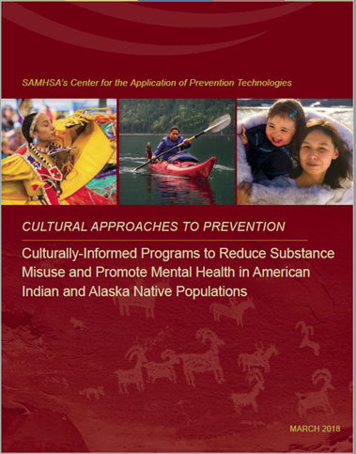
Program Inventory
What programs and strategies have been developed to address promote health among tribes?

Slide 28
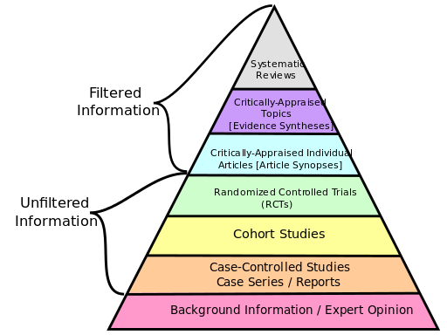
Culturally-Informed Programs

Slide 29
Culturally-Informed Programs
Practical Experience
Best Research Evidence
Values and Traditions
EBP

Slide 30
Program Directory: Development
We consulted multiple sources.
Athena Forum
Child Trends
First Nations Behavioral Health Association
Indian Health Service
Johns Hopkins’ Center for American Indian Health
OJJDP Model Programs
One Sky Center
Public Health Agency of Canada
SAMHSA NREPP
DHHS Home Visiting

Slide 31
Program Directory: Development
Tribal experts asked that we:
Separate programs into two categories—Western-based evaluation and practice-based.
Rate programs based on strength of evidence.
Indicate whether program was developed by tribes, with tribes, or for tribes.
Mention cost of implementation.
Make available full text of studies.

Slide 32
Program Directory: End Product
The final program directory:
Features 71 programs divided into two sections:
  42 evaluated using Western evaluation methods
  29 developed and refined using practice-based evidence
Organized by population groups
Highlights cultural elements
Focuses on reducing substance misuse and improving emotional, mental, and/or physical health

Slide 33
Product Directory: End Product
First, programs sorted by outcomes
Outcome | Have Evaluation Documentation | Practice-Informed
Mental Health Promotion | Caring for the Circle Within Cherokee Talking circle FACE (Family and Child Education) Program Families and Schools Together (FAST) for American Indian Children Family Spirit Healing of the Canoe Project | Alaskan Rural Human service Program Discovering Our Story Honoring Children Making Relatives Honoring Children, Mending the Circle LEAP (Lapwai Equine Assisted Program for Life Enrichment)

Slide 34
Product Directory: End Product
  For programs with evaluation documentation, information organized by:
  Description
  Costs
  Developer
  Populations
  Settings
  Evaluation Design
  Evaluation Outcomes
  Evaluation Studies
  Featured Source
  Contact Information
  Resources

Slide 35
Product Directory: End Product
  For practice-based programs, information organized by:
  Description
  Costs
  Developer
  Populations
  Settings
  Featured Source
  Website
  Resources

Slide 36
Program Directory: Applications
Use the information in this tool to:
Look at protective factors
Identify relevant programs
Determine strength of evidence
Balance strength of evidence against other needs
Refine your search by considering outcomes
Determine feasibility of implementation
Develop an evaluation plan, if needed

Slide 37

Questions?

Slide 38


CLOSING THOUGHT

Slide 39
THANK YOU
tyellowhammer@edc.org
mvalenti@edc.org
kdash@edc.org
PREVENTION SOLUTIONS@EDC CULTURAL APPROACHES TO PREVENTION: TOOLS TO GUIDE PRACTICE
39

