Slide 1

Using a Trauma-Informed Lens to Inform Substance Misuse Prevention
Marie Cox, Project Director, Southwest Prevention Center, University of Oklahoma
Jessica Goldberg, Training and Technical Assistance Specialist,
Education Development Center (EDC)
Gisela Rots, Project Director, EDC

Slide 2

Getting Started: Add a footer
Today’s Roadmap
Exploring the Evidence
Add a footer to your presentation
  Select INSERT/HEADER AND FOOTER from the main menu
  Type in the footer information in the proper field and click on APPLY TO ALL
Making Connections
A Trauma-informed Prevention Approach
Questions and Wrap Up

Slide 3

Exploring the Evidence
PREVENTION SOLUTIONS@EDC Using a Trauma-Informed Lens to Inform Substance Misuse Prevention 3

Slide 4

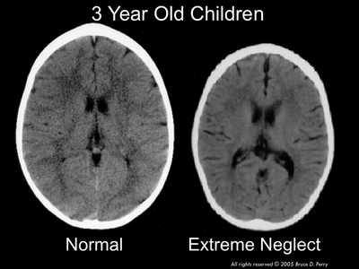
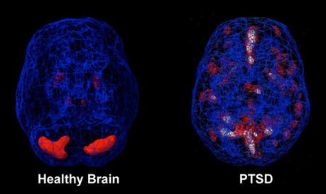
Understanding Brain Function
PREVENTION SOLUTIONS@EDC Using a Trauma-Informed Lens to Inform Substance Misuse Prevention 4

Slide 5
Toxic Stress
Substance Misuse and Disorders
Risk and Protective Factors
Family/Caregiver Substance Use
PREVENTION SOLUTIONS@EDC Using a Trauma-Informed Lens to Inform Substance Misuse Prevention 5

Slide 6
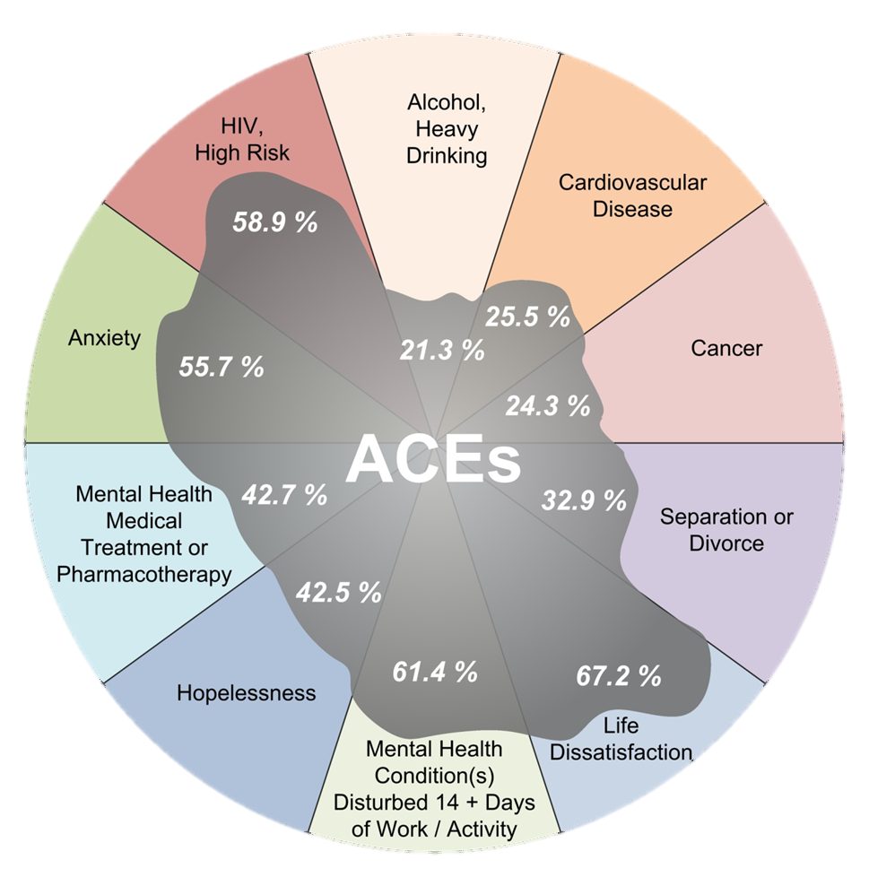
ACEs and Related Problems
Population attributable risk
for ACEs-attributable problems ranges from 14% to 80%
Data from: ACE and Population Health in Washington; Anda & Brown; 2009
PREVENTION SOLUTIONS@EDC Using a Trauma-Informed Lens to Inform Substance Misuse Prevention 6

Slide 7
Historic trauma
Ongoing oppression experiences
Adverse childhood experiences
Adverse peer/school experience
Adverse adult experience
Multiple Mental, Physical, Relational, and/or Productivity Problems
Trauma Transmission Risk
PREVENTION SOLUTIONS@EDC Using a Trauma-Informed Lens to Inform Substance Misuse Prevention 7

Slide 8

What Do We Know About Traumatic Events vs. Traumatic Stress?
More or less risk/resiliency in the individual
Changes in the brain
Single Event
The brain may heal itself more or less easily based on a number of factors…
PREVENTION SOLUTIONS@EDC Using a Trauma-Informed Lens to Inform Substance Misuse Prevention 8

Slide 9

So What?
Prevention practitioners are in a position to:
Interrupt the intergenerational transmission of toxic stress
Mitigate the effects of childhood trauma
Provide trauma-informed prevention services
PREVENTION SOLUTIONS@EDC Using a Trauma-Informed Lens to Inform Substance Misuse Prevention 9
Notes:
https://pixabay.com/en/silhouette-dancing-jumping-people-3095150/

Slide 10

Making Connections
PREVENTION SOLUTIONS@EDC Using a Trauma-Informed Lens to Inform Substance Misuse Prevention 10

Slide 11
Determining the Burden of Trauma and Toxic Stress in Your Community
The CDC Behavioral Risk Factor Surveillance System (BRFSS) ACEs module
Child welfare data and reports
Existing program data
New program protocols and intake
Key informant interviews
Community context
PREVENTION SOLUTIONS@EDC Using a Trauma-Informed Lens to Inform Substance Misuse Prevention 11

Slide 12

PREVENTION SOLUTIONS@EDC Using a Trauma-Informed Lens to Inform Substance Misuse Prevention 12

Slide 13
Considerations for Collaboration
Who has the necessary expertise?
Who has the authority to speak on this issue?
Who can influence policy and practice norms?
Who can shape social and cultural norms?
Who can teach or model effective approaches?
Who has or can build the right relationships?
How does partnership look different when addressing trauma?
PREVENTION SOLUTIONS@EDC Using a Trauma-Informed Lens to Inform Substance Misuse Prevention 13

Slide 14

Potential Collaborators
Criminal justice
DCF / Foster Care
Family and friends
Family navigators
Health care providers
Law enforcement
Medical Professionals
People who use drugs
Recovery professionals/peers
School personnel and out-of-school providers
Treatment providers
PREVENTION SOLUTIONS@EDC Using a Trauma-Informed Lens to Inform Substance Misuse Prevention 14

Slide 15
Opportunities for Collaboration
Identify shared risk and protective factors
Build community knowledge related to the intersection of substance misuse and trauma
Establish opportunities for co-locating services
Develop cross-organization trauma-informed service standards
Identify high-need subgroups for targeted interventions
PREVENTION SOLUTIONS@EDC Using a Trauma-Informed Lens to Inform Substance Misuse Prevention 15

Slide 16

So What?
By making connections and sharing resources, prevention practitioners can:
Create a cross-sector data profile of trauma and toxic stress in the community
Identify community-specific best practices for building trauma-informed approaches
Align prevention activities with existing trauma-focused services
PREVENTION SOLUTIONS@EDC Using a Trauma-Informed Lens to Inform Substance Misuse Prevention 16
Notes:
https://pixabay.com/en/photos/?q=arm+around&image_type=illustration&cat=&min_height=&min_width=&order=popular

Slide 17

What Does this mean for Prevention Practice?
PREVENTION SOLUTIONS@EDC Using a Trauma-Informed Lens to Inform Substance Misuse Prevention 17

Slide 18
Trauma-Informed Approaches
Trust
Safety
Trauma-Informed Approaches
Support
PREVENTION SOLUTIONS@EDC Using a Trauma-Informed Lens to Inform Substance Misuse Prevention 18

Slide 19
How Language Creates Change
What’s wrong with me, that my life feels so hard?
It’s not what’s wrong with you; it’s what happened to you….
PREVENTION SOLUTIONS@EDC Using a Trauma-Informed Lens to Inform Substance Misuse Prevention 19

Slide 20
Capability
Attachment & Belonging
Community, Culture, Spirituality
PREVENTION SOLUTIONS@EDC Using a Trauma-Informed Lens to Inform Substance Misuse Prevention 20

Slide 21
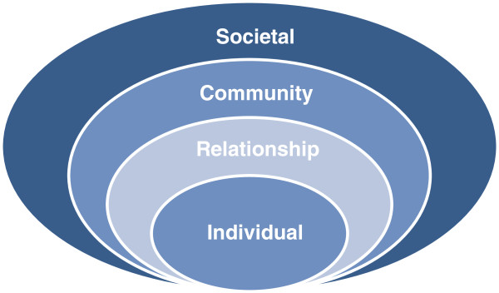
Trauma-Informed Adaptations for Prevention Practice
Consider strategies that:
target the individual level through support for effective coping skills
target the relationship level by building and supporting attachment
target the community level by building capacity to increase protective factors
target the societal level by supporting policies that reduce stigma and increase safety.
PREVENTION SOLUTIONS@EDC Using a Trauma-Informed Lens to Inform Substance Misuse Prevention 21
Notes:
https://www.researchgate.net/figure/The-Social-Ecological-Model-according-to-Dahlberg-Krug-19_fig3_260148322

Slide 22
Putting It Into Practice
Information dissemination
Prevention education
Alternative activities
Problem identification and referral
Community-based processes
Environmental approaches
PREVENTION SOLUTIONS@EDC Using a Trauma-Informed Lens to Inform Substance Misuse Prevention 22

Slide 23
Let’s Recap
Children exposed to opioid misuse in the home may experience trauma, which can have cyclical and intergenerational impacts when not addressed.
Trauma-informed approaches, rooted in safety and trust, can further support prevention strategies in the community.
Prevention practitioners have an important role to play in mitigating the impact and intergenerational transmission of ACEs, and trauma more generally, by promoting use of a trauma/ACE-informed lens for prevention efforts.
PREVENTION SOLUTIONS@EDC Using a Trauma-Informed Lens to Inform Substance Misuse Prevention 23

Slide 24

Questions?

Slide 25
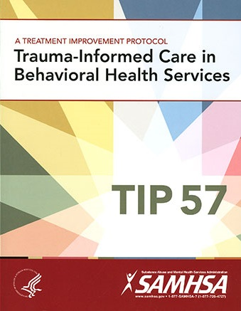
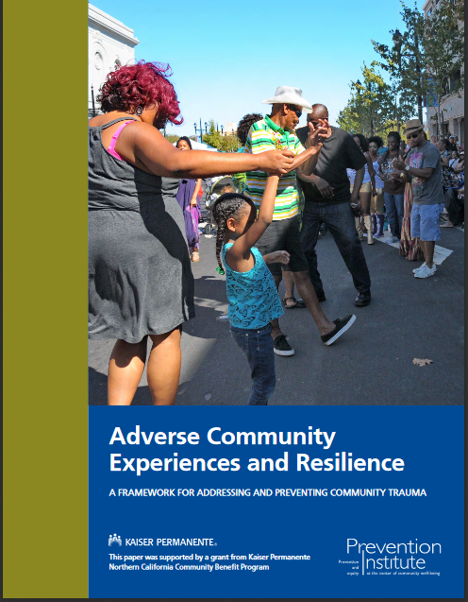

Resources
PREVENTION SOLUTIONS@EDC Using a Trauma-Informed Lens to Inform Substance Misuse Prevention 25

Slide 26

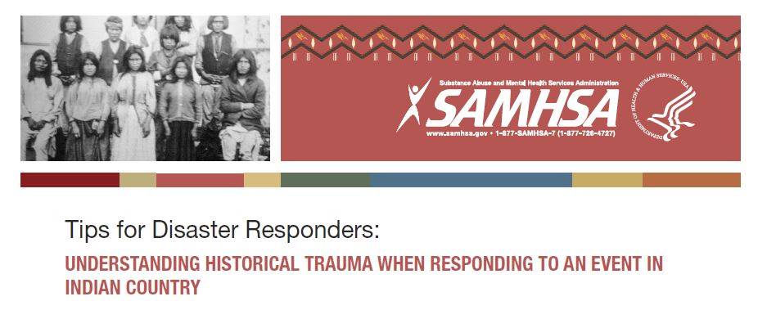
Resources for Native Communities
PREVENTION SOLUTIONS@EDC Using a Trauma-Informed Lens to Inform Substance Misuse Prevention 26

Slide 27
Resources
Archived Webinar: Trauma & Adverse Childhood Experiences: Implications for Preventing Substance Misuse
Archived Webinar: A Critical Look at Intergenerational Trauma and Substance Misuse: Implications for Prevention
Handout: The Role of Adverse Childhood Experiences in Substance Abuse and Related Behavioral Health Problems
PREVENTION SOLUTIONS@EDC Using a Trauma-Informed Lens to Inform Substance Misuse Prevention 27

Slide 28
THANK YOU!
Marie Cox
mariecox@ou.edu
Jess Goldberg
jgoldberg@edc.org
Gisela Rots
grots@edc.org
PREVENTION SOLUTIONS@EDC TITLE OF POWERPOINT PRESENTATION HERE 28

Slide 29
References
¹Brave Heart, M. Y. H. Historical Trauma and Unresolved Grief: Implications for Clinical Research and Practice with Indigenous Peoples of the Americas. (PDF document). Retrieved from https://www.ihs.gov/telebehavioral/includes/themes/newihstheme/display_objects/documents/slides/historicaltrauma/historicaltraumaintro_011113.pdf
²Toxic Stress. (2017). Retrieved from https://developingchild.harvard.edu/science/key-concepts/toxic-stress/
³American Psychiatric Association. (2003). Diagnostic and Statistical Manual of Mental Disorders. 5th ed. Arlington, VA: American Psychiatric Publishing, Inc.
⁴van der Kolk, B.A. (n.d.). Developmental trauma disorder: Towards a rational diagnosis for children with complex trauma histories. Retrieved from http://www.traumacenter.org/products/pdf_files/preprint_dev_trauma_disorder.pdf
⁵Anda, R. F., Dong, M., Brown, D. W., Felitti, V. J., Giles, W. H., Perry, G. S., Valerie, E. J., & Dube, S. R. (2009). The relationship of adverse childhood experiences to a history of premature death of family members. BMC Public Health, 9(106). doi: 10.1186/1471-2458-9-106.
⁶Centers for Disease Control and Prevention. (2016). Adverse Childhood Experiences (ACEs). Retrieved from https://www.cdc.gov/violenceprevention/acestudy/index.html
  ⁷Teicher, M. H. (2016). The effects of childhood maltreatment on brain structure, function and connectivity. Nature Reviews Neuroscience, 17, 652–666. doi:10.1038/nrn.2016.111
  ⁸Institute of Medicine. 2000. From Neurons to Neighborhoods: The Science of Early Childhood Development. Washington, DC: The National Academies Press. https://doi.org/10.17226/9824.
  ⁹Ehlers, C. L., Gizer, I. R., Gilder, D. A., Ellingson, J. M., & Yehuda, R. (2013) Measuring historical trauma in an American Indian Community Sample: Contributions of substance dependence, affective disorder, conduct disorder and PTSD. https://www.ncbi.nlm.nih.gov/entrez/eutils/elink.fcgi?dbfrom=pubmed&retmode=ref&cmd=prlinks&id=23791028
  ¹⁰Segal, B. (1995). Prevention and culture: A theoretical perspective. Journal of Drugs and Society, 8, (3-4), 139-147.
¹¹Teicher, M. H. (2017). https://drteicher.wordpress.com/2017/11/15/royal-society-of-medicine-london-psychiatry-in-dialogue-with-society-distinguished-lecture-november-14-2017/
¹²Perry, B. D. (1999). Splintered Reflections: Images of the Body in Trauma. In J. Goodwin and R. Attias (Eds.), Memories of fear. New York, NY: Basic Books.
¹³Felitti, V.J., Anda, R.F., Nordenberg, D., Williamson, D.F., Spitz, A.M., Edwards, V., Koss, M.P. & Marks, J.S. (1998). Relationship of childhood abuse and household dysfunction to many of the leading causes of death in adults: The adverse childhood experiences (ACE) study. American Journal of Preventative Medicine, 14(4); 245-258. Rights: Elsevier.
¹⁴Clucas, A., & Clark, V. (1992). Module II 7: Drug and alcohol problems in special populations. In M. A. Naegle (Ed.), Substance Abuse Education in Nursing, 2, 531-547. New York, NY: National League for Nursing.
¹⁵Substance Abuse and Mental Health Services Administration. (2014) Improving cultural competence. Treatment Improvement Protocol (TIP) Series No. 59. HHS Publication No. (SMA) 14-4849. Rockville, MD: Substance Abuse and Mental Health Services Administration.
¹⁶Brook, J., Akin, B., Lloyd, M., Bhattarai, J.,& McDonald, T. (2016). The Use of Prospective Versus Retrospective Pretests with Child-Welfare Involved Families. Journal of Child and Family Studies, 25, 2740-2752.
¹⁷Schaefer, C., Swenson, C., Tuerk, E., & Henggeler, S. (2013). Comprehensive treatment for co-occurring child maltreatment and parental substance abuse: Outcomes from a 24-month pilot study of the MST-Building Stronger Families program. Child Abuse & Neglect, 37, 596-607
¹⁸Reeves, A., Wyncoop Simmons, K., Porter, L. (2014) 2009-2011 BRFSS Analysis of Population Attributable Risk for Behavioral Health, Comprehensive Health Education Foundation.
¹⁹Van der Kolk, B. (2014). The body keeps the score: Mind, brain and body in the transformation of trauma. Penguin UK. (p. 38)
²⁰SAMHSAs National Center for Trauma-Informed Care & Alternatives to Seclusion and Restraint. Trauma-Informed Approach and Trauma-Specific Interventions. ’https://www.samhsa.gov/nctic/trauma-interventions
²¹Rudd, R. A., Seth, P., David, F., & Scholl, L. (2016). Increases in drug and opioid-involved deaths – United States, 2010-2015. MMWR, 65(5051), 1445-1452.
²²Levenson, M. (October, 2015). Concern mounts on opioid crisis’ toll on children. Boston Globe, Retrieved from http://www.bostonglobe.com.
PREVENTION SOLUTIONS@EDC Using a Trauma-Informed Lens to inform Substance Misuse Prevention 29

